Slide 1
COVID Data Visualization for Quality Education

Slide 2
Project Team :
Annam Sai Manohar
Kolapalli Naga Venkatesh
Paramsetti Manoj
Ravipati Abhiram

Slide 3
Problem Statement :
During these tough times safety is the utmost importance of the students and teachers. At the same time, classes must be conducted as usual. So, we came up with an idea where we use the data of current COVID cases all over the world and predict whether the classes can be conducted through online or offline based on the COVID statistics.

Slide 4
Description :
This Machine Learning model predicts whether the students to attend online or offline classes by collecting data from an API that is hosted in a static website made with Reactjs. The data is given in the form of a pie chart which is a pictorial representation of data.
This machine learning model is powered by Lobe. Lobe is a highly specialized platform for Machine Learning projects that users can teach their model how to work based on image classification. Lobe has everything you need to bring your machine learning ideas to life.

Slide 5
Purpose behind this Project :
We have done this project as part of HACK THE MOUNTAINS 2.O Hackathon.

Slide 6
Technology Stack Used :
Machine Learning
TensorFlow js
React js

Slide 7



Track :
Open Innovation

Slide 8
How it works?
04
Collecting data from Modern API
ML image classification is used to predict the analysis
01
03
Statistics are divided into infected people, non-affected people and number of deaths.
Generating a pie-chart based on stats
02

Slide 9
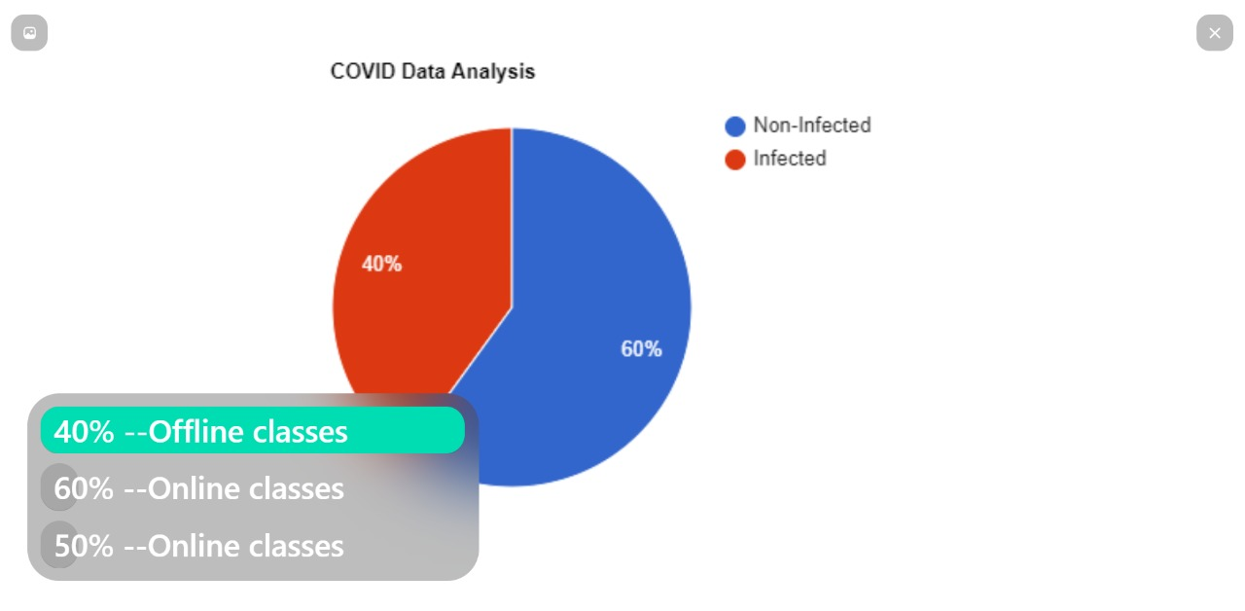
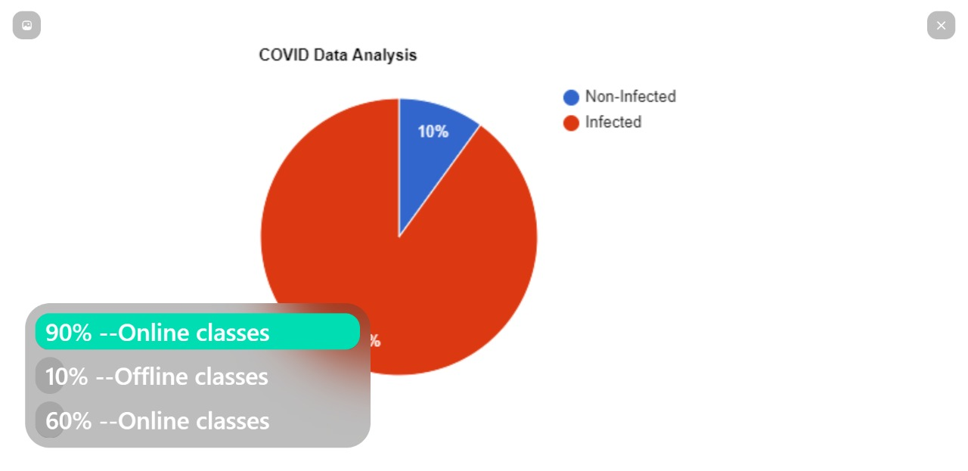
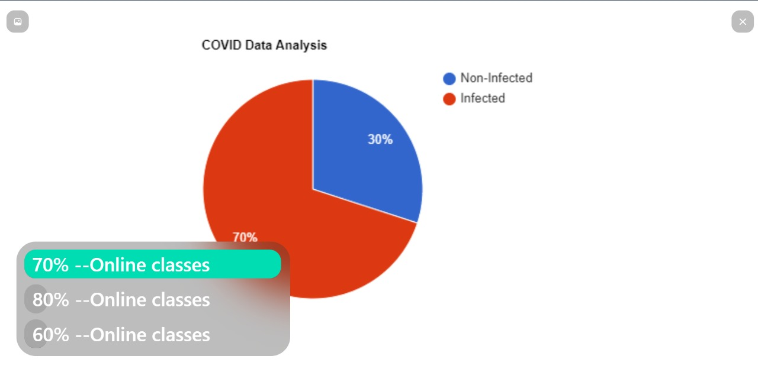

Slide 10
GitHub Link :
https://github.com/saimanoharhm/covid-predective-analysis

Slide 11
Thank You

